Slide 1
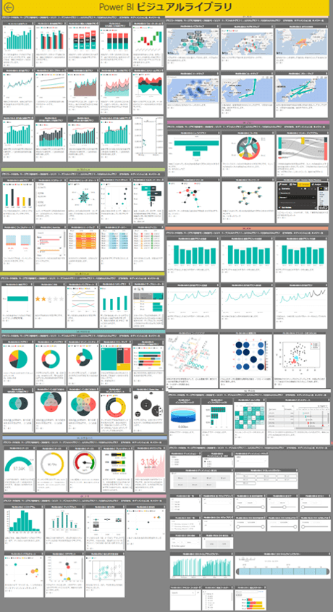
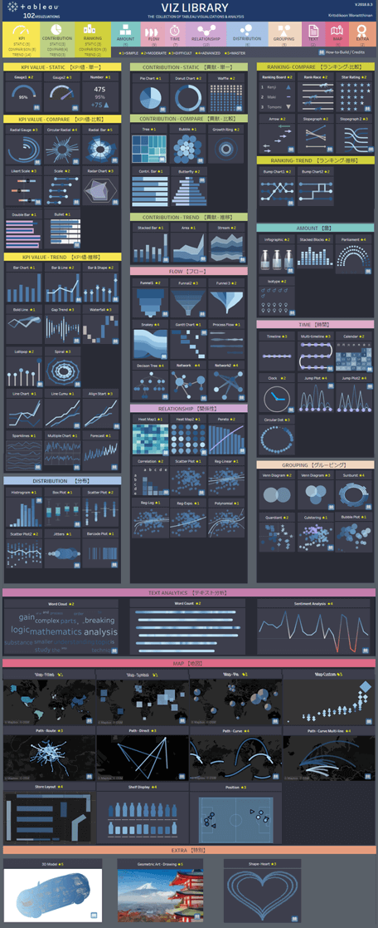
LIVE DEMO
LIVE DEMO

Slide 2





Slide 3















LIVE DEMO
CONCEPTUAL MOCKUP
ENVIRONMENT
DEV
SERVER
USER
VS CODE
Colab
Tensorflow.js
Tensorflow.js
Local + Cloud
GitHub Pages: static site
AI at the Edge

Slide 4















AI環境構築：PaaS
項目 | 内容
企業 | 電化製品 技術開発部
開発期間 | 2ヶ月 Hands-on資料
社内
管理者リソースグループ
管理者
ユーザーリソースグループ
AD認証
ネットワークセキュリティグループ
コスト リソース
MLサービスワークスペース
開発者
ストレージ
コンピューティング
レジストリ
データ
学習
モデル
AD認証

Slide 5


CONCEPTUAL MOCKUP
PaaS : AI Development Cloud Architecture
Local
Admin Resource Group
Administrator
Dev Resource Group
AD
Network Security
Cost Resource
Azure ML Service Workspace
Deployment
Developer
Bob Storage
Compute
Model Registration
Data
Training
Model
AD
https://jingwora.github.io/

Slide 6
CONCEPTUAL MOCKUP
PaaS : AI Development Cloud Resources
Local
Administrator
AD
Cost Resource
Control
Azure ML
Service
Bob
Storage
Compute
Developer
Model
Registration
Network
Security
AD
https://jingwora.github.io/

Slide 7





AI環境構築：IaaS
項目 | 内容
企業 | 電化製品 技術開発部
開発期間 | 2ヶ月 Hands-on資料
社内
リソースグループ
仮想マシン Public
仮想マシン Private
開発者
ネットワークセキュリティグループ
ネットワークセキュリティグループ
AD認証
Driver Docker
Container
Docker イメージ
Docker イメージ

Slide 8
CONCEPTUAL MOCKUP
IaaS : AI Development Cloud Architecture
Local
Resource Group
Private
VM
Public
VM
Developer
Network Security Group
Network Security Group
AD認証
Driver Docker
Container
Docker Image
Docker Image
https://jingwora.github.io/

Slide 9
CONCEPTUAL MOCKUP
IaaS : AI Development Cloud Resources
Local
Virtual
Machine
Docker
Compute
Developer
AD
Bob
Storage
Network
Security
https://jingwora.github.io/

Slide 10






AI環境構築：推論モデル・Kubernetes
項目 | 内容
企業 | 電化製品 技術開発部
開発期間 | 2ヶ月 Hands-on資料
社内
リソースグループ
MLサービスワークスペース
開発者
仮想マシン Private
Kubernetes
AD認証
ストレージ
コンピューティング
レジストリ
デプロイ
学習
モデル
Model
Web app
データ
Model
Web app
Model
Web app
ユーザー
Application Gateway
Load Balancer
AD認証

Slide 11
CONCEPTUAL MOCKUP
Kubernetes Deployment : AI Development Cloud Architecture
Local
Resource Group
ML Service
Developer
Private
VM
Kubernetes
AD認証
Blob Storage
Compute
Register
Deployment
Train
Model
Model
Web app
Data
Model
Web app
Model
Web app
User
Application Gateway
Load Balancer
AD認証
https://jingwora.github.io/

Slide 12
CONCEPTUAL MOCKUP
Kubernetes Deployment : AI Development Cloud Resources
Local
Developer
Blob Storage
AD
Azure ML
Service
Compute
Register
Application
Gateway
Network
Security
NGINX
Docker
Kubernetes
Load Balancer
Model
Web app
User
AD
https://jingwora.github.io/

Slide 13



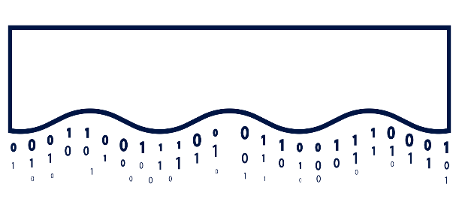







CONCEPTUAL MOCKUP
MLOP / ML Orchestration
Data Prep
Feature
Store
Business Intelligence
Machine Learning
Data Prep
Data Prep
Structured, Semi-Structured and Unstructured Data
https://jingwora.github.io/

Slide 14















Databricks Machine Learning
A data-native and collaborative solution for the full ML lifecycle
Data Science Workspace
AutoML
Data
Prep
Model Training
Model Tuning
Runtime and Environments
Batch Scoring
Online Serving
Data Versioning
Feature Store
Batch (high throughput)
Monitoring
Real time (low latency)
MLOps / Governance
Open Data Lakehouse Foundation with

Slide 15
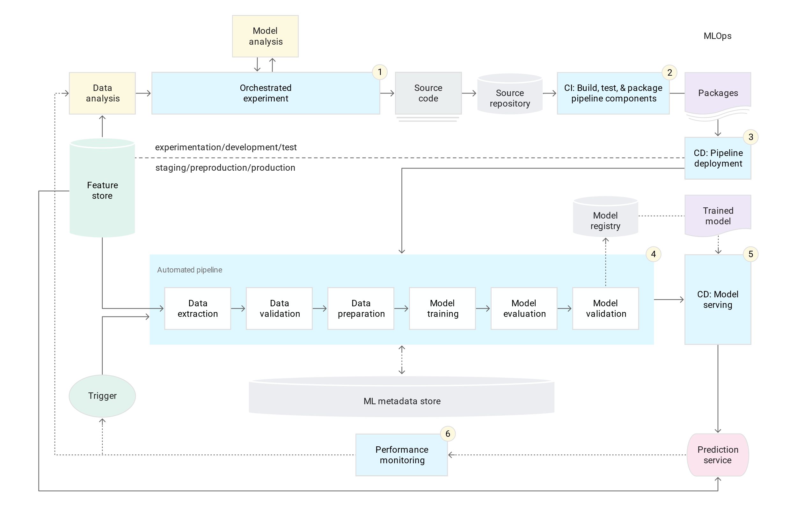

Slide 16
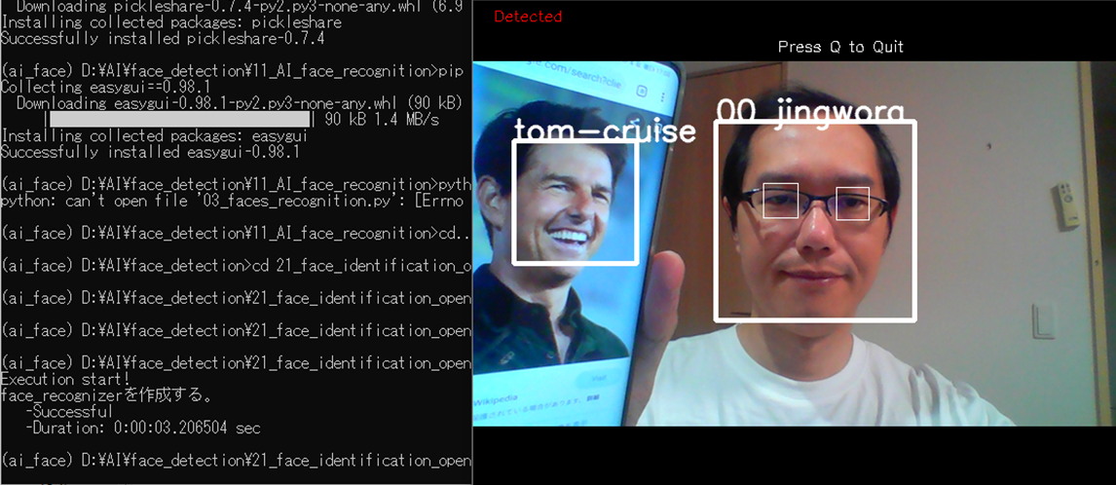




CONCEPTUAL MOCKUP
Face Recognition Framework
https://jingwora.github.io/
Train
Model
Face
Name
User
Live Camera

Slide 17
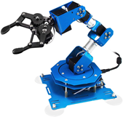


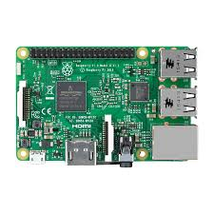

CONCEPTUAL MOCKUP
Object detection IOT
Live
https://jingwora.github.io/
Raspberry Pi
Camera
Robotic Arm

Slide 18



LIVE DEMO

Slide 19


Slide 20
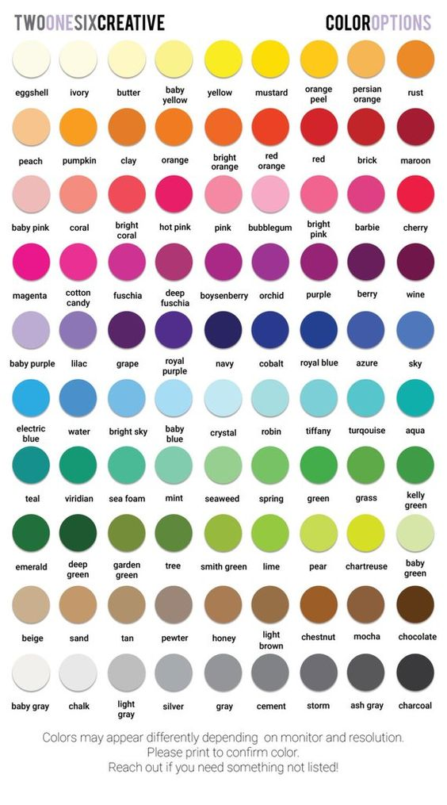
Total quality management (TQM)
4M Analysis Process
4M
 | Machine | Material | Man | Method
Plan
Actual
QA Status
 | Checking | Checked | Status | IQ
Line1
Line2
Line3
Line4
PPM
PPM
Claim
Defect

Slide 21

CONCEPTUAL MOCKUP
PRODUCTION REPORT
PRODUCTION LINE STATUS 製造ライン状況
● LIVE
COUNTRY 国 |  | REGION 地域 |  | FACTORY 工場 |  | BUILDING ビル
Japan | ▼ | Kantou | ▼ | JF001 | ▼ | B001 | ▼
OPRATION TIME 活動時間
(Actual vs Plan)
STOP TIME 停止期間
(Actual vs Plan)
BREAK TIME 休憩時間
(Actual vs Plan)
CURREN TIMELINE
現在タイムライン
(Actual vs Plan)
8,250
(85%)
350
(120%)
920
(95%)
78%
Line No. | Operation Timeline タイムライン |  |  |  |  |  |  |  |  |  |  |  |  |  |  |  |  |  |  |  |  |  |  |  | Current Status | Stop Time (minute) |  | ▲
LX101 |  |  |  |  |  |  |  |  |  |  |  |  |  |  |  |  |  |  |  |  |  |  |  |  | OP | 30 | ℹ
LD220 |  |  |  |  |  |  |  |  |  |  |  |  |  |  |  |  |  |  |  |  |  |  |  |  | BK | 0 | ℹ
LL201 |  |  |  |  |  |  |  |  |  |  |  |  |  |  |  |  |  |  |  |  |  |  |  |  | ST | 320 | ℹ
LX201 |  |  |  |  |  |  |  |  |  |  |  |  |  |  |  |  |  |  |  |  |  |  |  |  | OP | 0 | ℹ
LB301 |  |  |  |  |  |  |  |  |  |  |  |  |  |  |  |  |  |  |  |  |  |  |  |  | OP | 0 | ℹ
7:00 | 9:00 |  |  |  | 11:00 |  |  |  | 13:00 |  |  |  | 15:00 |  |  |  | 17:00 |  |  |  | 19:00 |  |  |  |  |  |  | ▼
Line: LL201
Period: 14:00 – 17:00
Controller: John Walker
Memo: Machine Repair
ℹ get Details
Operation Status: ● Stop(ST) ● Break(BK) ● Operate(OP) ● Inactive(IA)
https://jingwora.github.io/

Slide 22
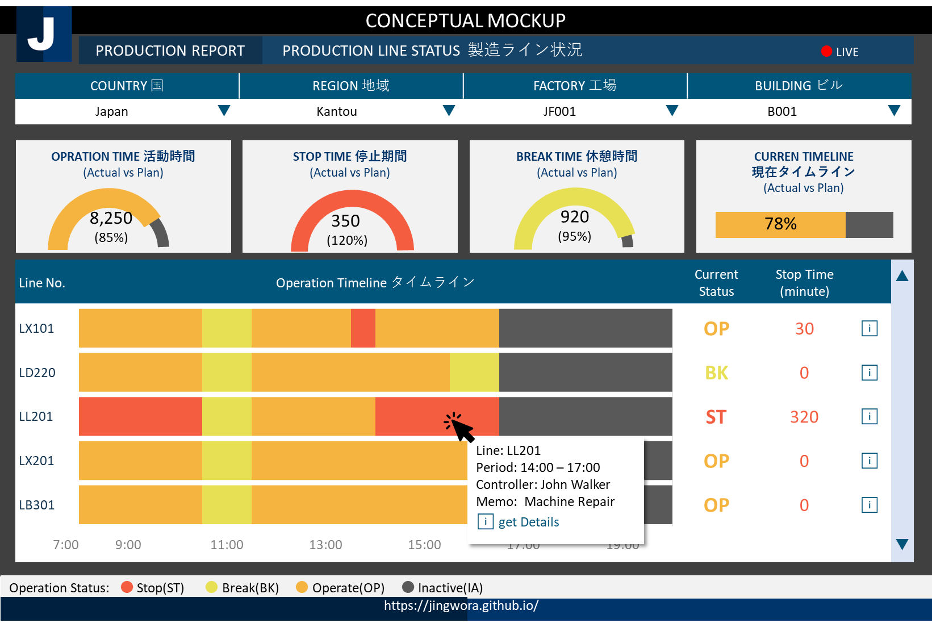






ENVIRONMENT ARCHETECTURE
DEV
OPS
USER
Data Warehouse
Ingest
SSMS
Data
Factory
SQL
Server
Power BI
Data Lake
Storage
Power BI
DAX
Language
Local + Cloud
Cloud
Visualization

Slide 23
CONCEPTUAL MOCKUP
FINANCIAL ANALYSIS REPORT 財務分析レポート
Region 地域
EU | ▼
Income Statement | Balance Sheet | Cash Flow | Financial Ratio | Root Cause | Simulation
 | 2018 |  | 2019 |  | 2020 YTD
 | Actual | Vs Budget | Actual | Vs Budget | Actual | Vs Budget
⊞ Net product sales | 79,000 | +200 | 82,000 | +200 | 101,000 | +200
⊞ Net service sales | 27,000 | -100 | 31,000 | -100 | 27,000 | -100
Total net sales | 96,000 | +100 | 113,000 | +100 | 127,000 | +100
⊟ Operating expense
Cost of sales | 71,000 | +400 | 61,000 | +400 | 81,000 | +400
Fulfillment | 13,000 | -200 | 15,000 | -200 | 19,000 | -200
Marketing | 5,000 | +300 | 4,000 | +300 | 4,000 | +300
Other operating expense | 500 | +10 | 600 | +10 | 500 | +10
Total operating expense | 88,500 | +400 | 78,500 | +400 | 94,500 | +400
⊞ Operating income | 2,500 | +200 | 3,500 | +200 | 4,400 | +200
⊞ Interest expense | (150) | -10 | (150) | -10 | (200) | -10
⊞ Other income | 100 | +50 | 100 | +50 | 100 | +50
Income before income taxes | 2,450 | +60 | 3,650 | +60 | 3,450 | +60
Provision for income taxes | (450) | -20 | (550) | -20 | (500) | -20
Net income | 2,000 | +50 | 3,100 | +50 | 2,800 | +50
Country 国
Germany | ▼
Branch 支店
Munich G01 | ▼
Fiscal Year 年度
FY2020 | ▼
Year | Quarter
EN | 日本 | 中国
Unit 単位
Million | ▼
Drill-Through
to get
more insights
ℹ get Details
Drill Down
Currency 通貨
Yen | ▼
https://jingwora.github.io/

Slide 24
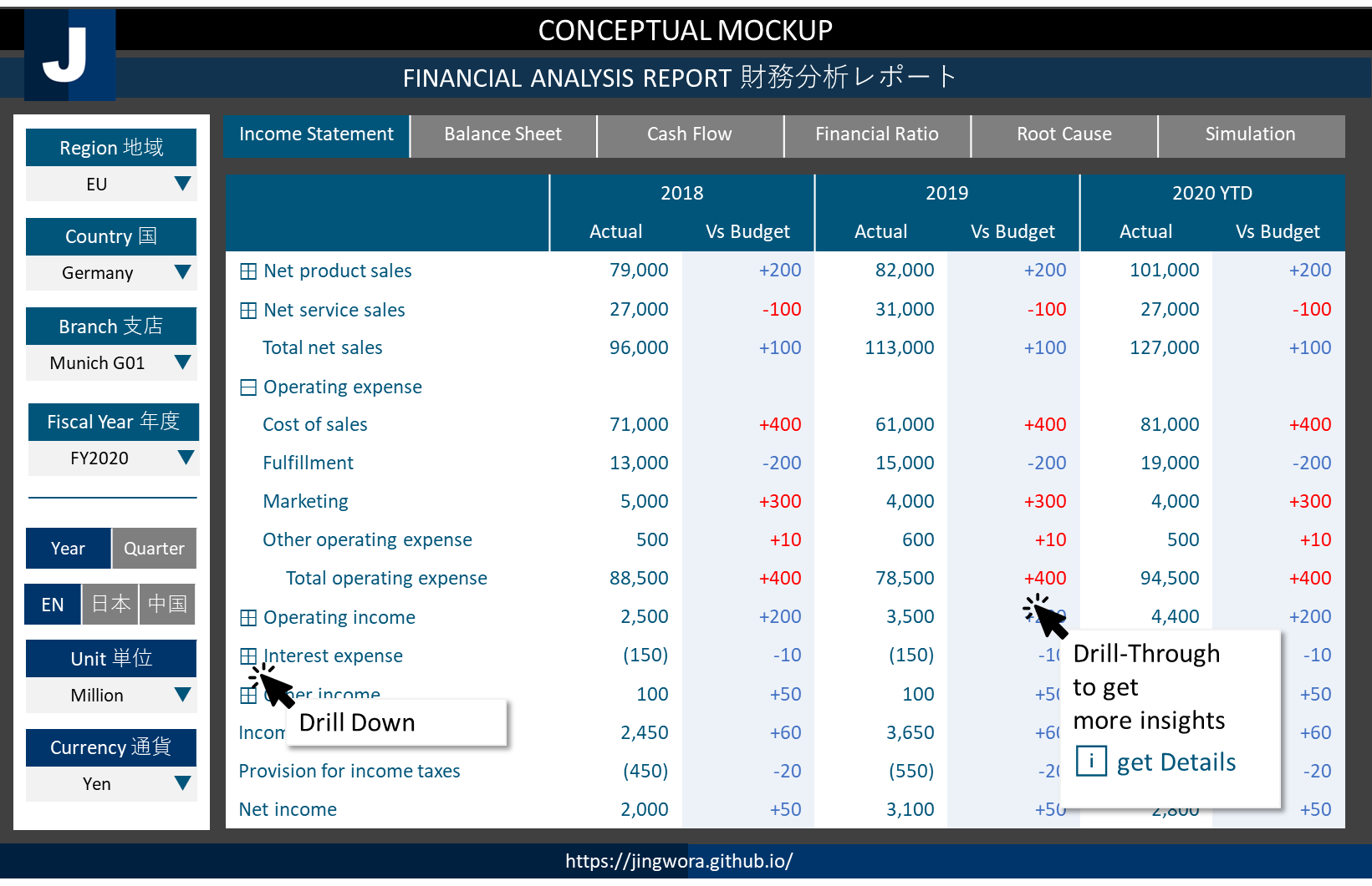

ENVIRONMENT ARCHETECTURE
DEV
OPS
USER
Data Warehouse
Ingest
SSMS
Data
Factory
SSAS
SQL
Server
Power BI
Data Lake
Storage
Power BI
DAX
Language
Local + Cloud
Cloud
Visualization

Slide 25
CONCEPTUAL MOCKUP
CUSTOMER TRANSACTION ANALYSIS 顧客のトランザクション分析
Period 期間
2020 | ▼
RFM | Sales Decomposition | Market Basket | Churn Analysis | Promotion Effectiveness | Customer Journey
RFM (No. of members) (vs LY)
 |  |  | ◀ | R1 | R2 | R3 | R4 | ▶
 | ▲
 | F4 |  | 15 +1 | 1,100 +10 | 500 -20 | 250 +20 | 12 +5
 | F3 |  | 110 -10 | 350 -10 | 320 +15 | 250 +5 | 41 +20
 | F2 |  | 207 +15 | 750 -100 | 550 +30 | 221 +15 | 315 +10
 | F1 |  | 310 -55 | 210 -20 | 130 -10 | 114 -10 | 312 -10
 | ▼
■ Platinum ■ Gold ■ Silver ■ Bronze ■ Churn
Profiles プロフィール
Area アリア
Kantou | ▼
Age
Male
38%
Branch 支店
Munich G01 | ▼
70%
60%
50%
30%
Female
62%
20’s 30’s 40’s 50’s
Recency 最終購入日
R1 | R2 | R3 | R4
1 | 2 | 3 | 4
Behavior 行動 (Product Contribution)
Frequency
Editable
Product1
Product2
Frequency 購入回数
F1 | F2 | F3 | F4
2 | 4 | 6 | 8
Product3
Get full list
For target marketing
ℹ get Details
Product4
Monetary 購入金額
M1 | M2 | M3 | M4
30 | 40 | 50 | 60
Value
https://jingwora.github.io/

Slide 26
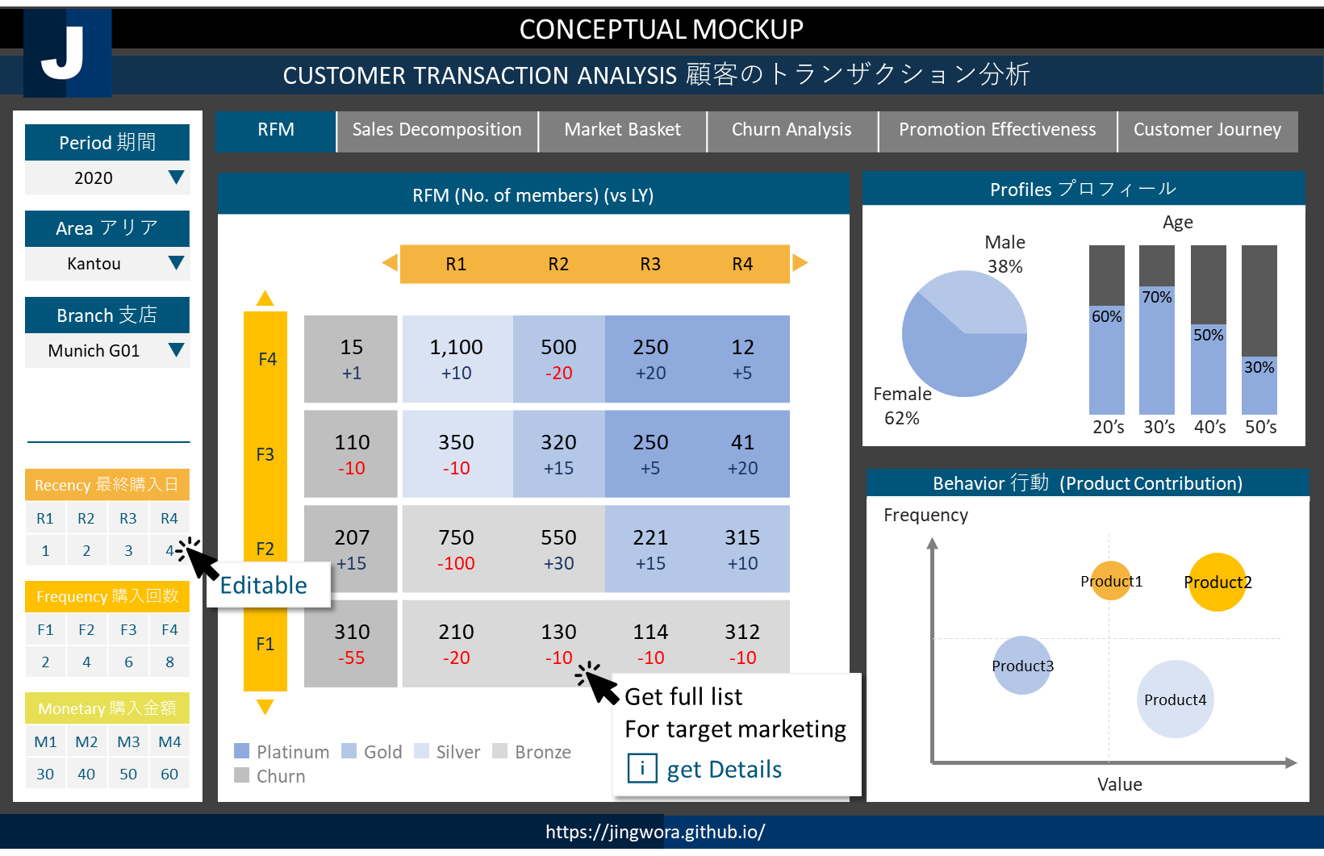
ENVIRONMENT ARCHETECTURE
DEV
OPS
USER
Data Warehouse
Ingest
SSMS
Data
Factory
SSAS
SQL
Server
Power BI
Data Lake
Storage
Power BI
DAX
Language
Local + Cloud
Cloud
Visualization

Slide 27
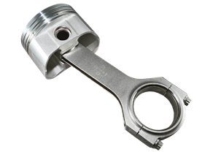
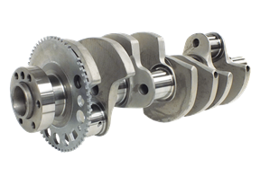
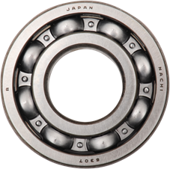
CONCEPTUAL MOCKUP
Material Management - Bill of Material (BOM)
Factory 工場
Factory 1 | ▼
BOM | Inventory Management | Order Status Analysis | Production Planning | Supply Chain Management | Cost Structure Simulation
Part No. | Description | Type | Quantity | Cost | Status | ▲
⊟ EN-101 | Assembly 1 | Assembly | 1 | 105 | Active
PX-101 | Parts 1 | Parts | 2 | 5 | Active
PX-102 | Parts 2 | Parts | 1 | 5 | Active
PX-103 | Parts 3 | Parts | 1 | 80 | Active
⊟ EN-102 | Assembly 2 | Assembly | 1 | 55 | Active
PX-104 | Pats 5 | Pats | 1 | 25 | Active
PX-105 | Parts 6 | Parts | 3 | 10 | Active
⊟ EN-103 | Assembly 2 | Assembly | 1 | 35 | Active
PX-106 | Parts 8 | Parts | 1 | 10 | Active
PX-107 | Parts 9 | Parts | 1 | 1 | Active | ▼
Detail Part No. EN-101
Department 部門
Department 1 | ▼
Catalog No. カタログNo.
ALL | ▼
Part No. パーツNo.
ALL | ▼
Description Gear Set EX | ▲
Dimension: 30*280*30
Weight: 1.5kg
Manufacturer: Manu1
Lead time: 15 days
 | ▼
BOM Structure
⊟ Product Group 1 | ▲
⊟ Product 1
■ Assembly 1
■ Assembly 2
□ Assembly 3
□ Assembly 4
□ Assembly 5
⊞ Product 2
⊞ Product 3
⊞ Product Group 2 | ▼
PX-101
PX-102
PX-103
EN-101
FXN-501
https://jingwora.github.io/

Slide 28
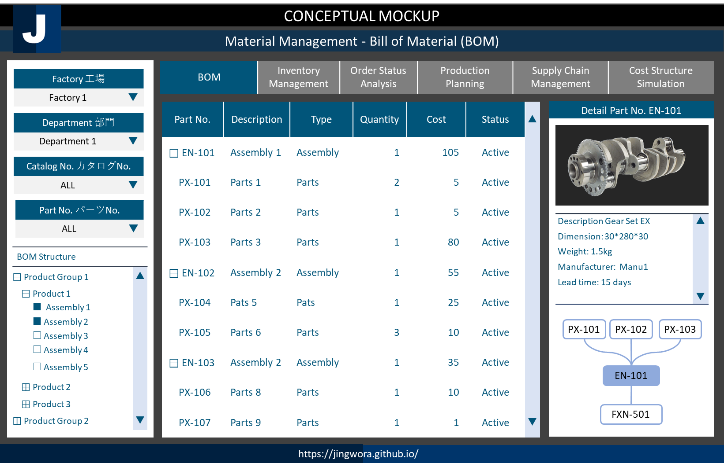



ENVIRONMENT ARCHETECTURE
DEV
OPS
USER
SQL
Workbench
Tableau
My SQL DB
Tableau
Local
On-prem
Visualization

Slide 29






CONCEPTUAL MOCKUP
Logistic Map Analysis 1
◀ | Logistic Map | World Map Inventory Status | Detail Report | ▶
Regions
Region 1 | ▼
Product Groups
ALL | ▼
Factory
Warehouse
Shipment
Store warehouse
Store
Inventory: 5,341
Stock day: 15
NORMAL
Inventory: 8,142
Stock day: 21
NORMAL
Inventory: 8,531
Stock day: 25
NORMAL
Inventory: 4,780
Stock day: 37
HIGH
Inventory: 1,337
Stock day: 11
LOW
Trend
Trend
Trend
Trend
Trend
Stock Day Level：■ Normal Level ■ Warning Low Level ■ Warning High Level
https://jingwora.github.io/

Slide 30
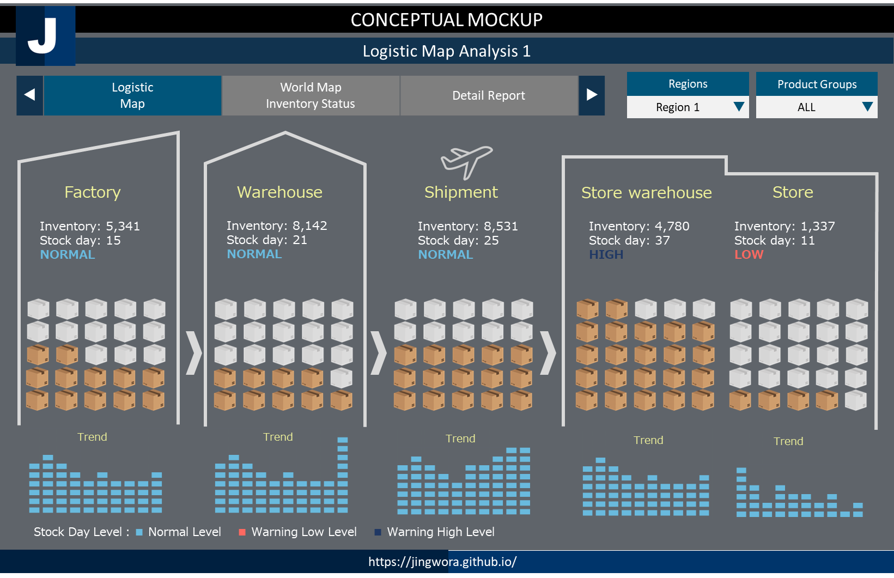
ENVIRONMENT ARCHETECTURE
DEV
OPS
USER
SQL
Workbench
Tableau
My SQL DB
Tableau
Local
On-prem
Visualization

Slide 31
CONCEPTUAL MOCKUP
INVENTORY MANAGEMENT 在庫管理
Region 地域
EU | ▼
Inventory Simulation | Inventory Cost Analysis | Stock turn Analysis | Supply chain Magement | PSI Report
Opportunity Loss Ranking 機会損失ランク
PSI
Country 国
Germany | ▼
Rank | Product ID | Product Name | Opportunity Loss | ▲
1 | 1011 | Product A
2 | 1020 | Product B
3 | 1001 | Product C
4 | 1002 | Product D
5 | 1201 | Product E
6 | 1355 | Product F
7 | 1702 | Product G
8 | 1822 | Product H
9 | 1677 | Product I
10 | 1022 | Product J |  | ▼
Unit
Department
ALL | ▼
2020 01 2020 02 2020 03 2020 04 2020 05 2020 06
Product 製品
ALL | ▼
● P (Production) ● S (Sales) ● I (Inventory)
Simulation シムレイション
Period 期間
2020 | ▼
Unit
2020 01 2020 02 2020 03 2020 04 2020 05 2020 06
Optimizer | 50 | 30 | 20 | 20
Fine-tuner | 0 | 0 | 50 | 50
Optimizer1 | ▼
● Production ● Auto-filled ● Adjusted Parameter
UPDATE
https://jingwora.github.io/

Slide 32
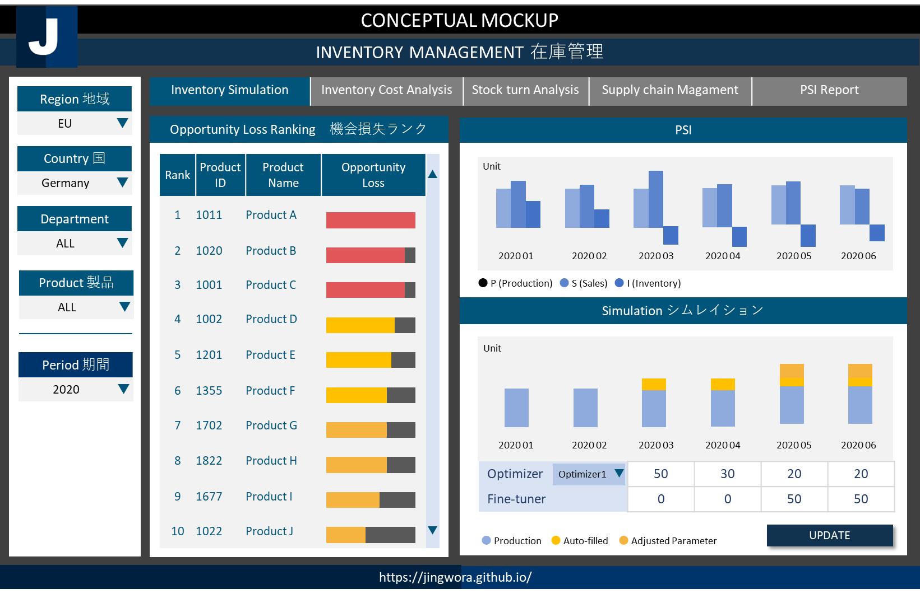





ソリューション：
売り上げ予測により製造・在庫の最適化
業務フローの最適化によるコストの削減
商品の組み合わせ変更による売り上げと利益の最大化
お客様情報：電子機械メーカー
Solutions:
Develop sales predictive model and inventory optimization model
Decrease operating cost by optimize process flow.
Identify the right product mix that optimize sales and profit.
Client: Electronic Machine Maker
ENVIRONMENT ARCHETECTURE
DEV
OPS
USER
Data Warehouse
Ingest
SSMS
Power BI
Data
Factory
SQL
Server
Power BI
Data Lake
Data Lake
Storage
Spark
Databricks
Power
App
PySpark
Azure
DevOps
Bronze | Silver | Gold
Local + Cloud
Cloud
Visualization

Slide 33
CONCEPTUAL MOCKUP
Demand Pattern Analysis 需要パターン解析
Country 国
Germany | ▼
Demand Overview 需要ダッシュボード | Seasonality & Trends 季節性・トレンド | Outliner 異常値 | Model Expandability 説明性 | …
Opportunity Loss Ranking 機会損失ランク
Department
ALL | ▼
Product Detail |  |  | Seasonal |  |  | Trend |  |  | Outliner |  | ▲
Rank | Product ID | Product Name | Seasonal Test | High Season | High Season Index | Trend Test | Slope | Change Points | Predicted Sales | Model Error (MAPE)
1 | 1011 | Product A | 1 | Mar | 121 | 1 | 10 | OCT-2020 | 15,000 | +/- 2%
2 | 1020 | Product B | 0 | Feb | 102 | 0 | 2 | - | 2,500 | +/- 10%
3 | 1001 | Product C | 1 | Dec | 110 | 1 | -5 | NOV-2020 | 7,950 | +/- 4%
… | … | … | … | … | … | … | … | … | … | … | ▼
Product 製品
ALL | ▼
Period 期間
2020 | ▼
Seasonal Index
Trends
Outliner
JAN | FEB | MAR | APR | MAY | JUN | JUL | AUG | SEP | OCT | NOV | DEC
●
Periods
● Actual ● Trend ● Change Point
Periods
● Actual ● Outliner
● Seasonal Index
https://jingwora.github.io/

Slide 34








ENVIRONMENT ARCHETECTURE
 | 1. Environment Preparation | 2. Raw Data Processing | 3. Standard Data Processing | 4. AutoML | 5. Reports
Process | Prepare development resources. | Load raw data and create standard data. | Autocorrelation, Statical test and Trend data processing | AutoML forecasting (1,000 models in 20 mins) | Create report
Resources | - DevOps - Azure Data Factory - Azure SQL Server - Spark Databricks - Blob Storages - Azure ML Service | Blob Storages Data factory Spark Databricks Azure SQL Server | Data factory Spark Databricks Azure SQL Server | Azure ML Service - Azure Compute Instant - Azure Compute Cluster - Azure App Service | Power BI Azure SQL Server
Input | - ARM Template - SQL .sln (DDL) - Git resource | CSV: - Sales - Product - Calendar | Database: - Sales - Product | Database: - Sales | Databases:
Output | All required environments | Delta Lake & Database: - Sales - Product - Calendar | Delta Lake & Database: - Autocorr - Stat test - Trend | Delta Lake & Database: - Sales Forecast - Sales Forecast Metrics | Power BI reports:
Development Tools
Codes
Data
Factory
Spark
Databricks
AML
SQL
Server
Power BI
Data Lake
Azure
DevOps
Git
SSMS
SQL
Python
PySpark
Raw
Data
(CSV)
Processed
Data
Statistics
AutoML
Database
Reports
Azure
App Service

Slide 35
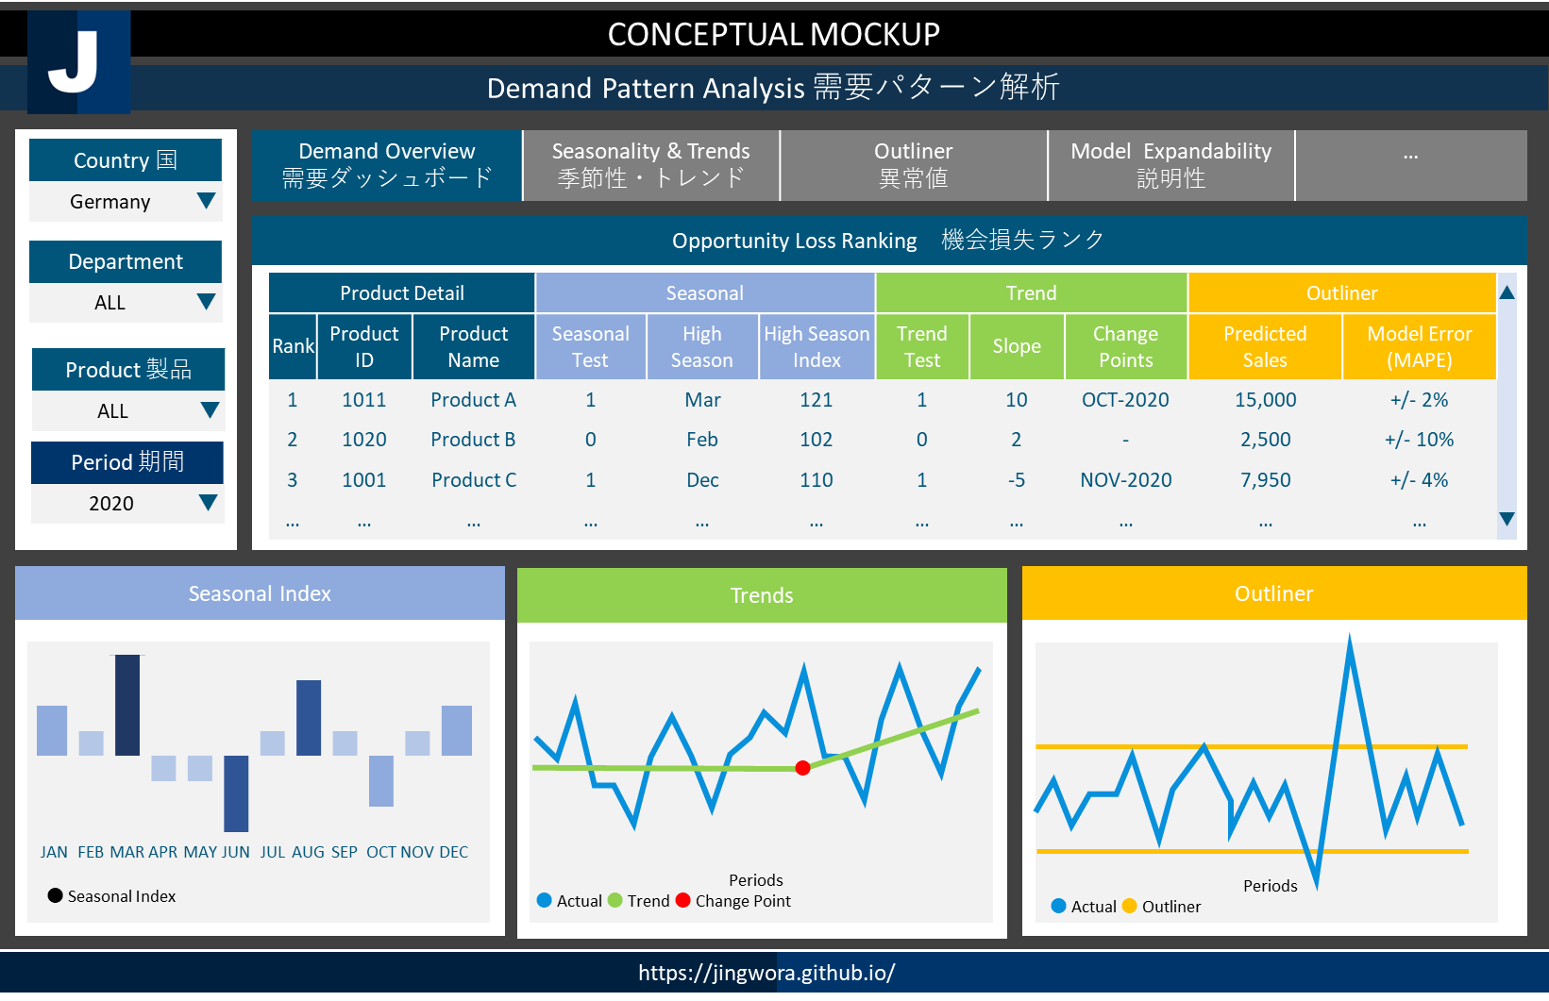

季節のパターンの理解に基づいて製造、販売の計画を最適化する
購買履歴、顧客属性に合わせて商品推奨で顧客育成、利益効率を高める、
消費者のニーズに合わせて新製品の機会と需要の発見
お客様情報：電子機械メーカー
Understand seasonal pattern to optimize production and sales plan.
Provide recommended product to optimize profit based on buying behavior and characteristic.
Understand customer need and find out new opportunity.
Client: Electronic Machine Maker
ENVIRONMENT ARCHETECTURE
DEV
OPS
USER
Data Warehouse
Ingest
SSMS
Data
Factory
SQL
Server
Power BI
PySpark
Data Lake
Data Lake
Storage
Spark
Databricks
Azure
DevOps
Bronze | Silver | Gold
Power BI
Local + Cloud
Cloud
Visualization

Slide 36

CONCEPTUAL MOCKUP
SENTIMENT：CUSTOMER JOURNEY センチメント・カスタマージャーニー
Sentiment 感情分析 | Drill-through ドリルスルー | Sentiment Trend 感情トレンド | By Area エリア別の分析 | By Product 製品別の分析 | Detail 詳細
Awareness
認知
Research
比較検討
Purchase
購入
Experience
顧客体験
Negative Rate
Negative Rate
Negative Rate
Negative Rate
15%
30%
10%
32%
Topics | Sentiments
Topic1
Topic2
Topic3
Topic4
Topic5
Topic6
Topic7
Topic8
Topics | Sentiments
Topic1
Topic2
Topic3
Topic4
Topic5
Topic6
Topic7
Topic8
Topics | Sentiments
Topic1
Topic2
Topic3
Topic4
Topic5
Topic6
Topic7
Topic8
Topics | Sentiments
Topic1
Topic2
Topic3
Topic4
Topic5
Topic6
Topic7
Topic8
Sentiment ：■ Positive ■ Neutral ■ Negative
https://jingwora.github.io/

Slide 37




ENVIRONMENT ARCHETECTURE
 | 1. Environment Preparation | 2. Data Processing | 3. Sentiment Analysis | 4. Reports
Process | Prepare development resources. | Load raw data and process data. | Keywords and sentiment processing | Create report
Resources | - Azure Data Factory - Azure SQL Server - Blob Storages - Azure Cognitive Service | Blob Storages Data factory Azure SQL Server | Azure cognitive service Data factory Azure SQL Server | Power BI Azure SQL Server
Input | - ARM Template - SQL .sln (DDL) | CSV: - phone - chatbot - email | Database: - Message - Category | Databases:
Output | All required environments | Database: - Message - Category - Calendar | Database: - Keywords - Sentiment | Power BI reports:
Data
Factory
Azure Text
Analytics API
SQL
Server
Power BI
CS phone
script
chatbot
email
Data Lake Storage
Raw
Data
(CSV)
Raw
Data
(CSV)
Raw
Data
(CSV)
Processed
Data
(CSV)
Sentiment
Database
Reports

Slide 38
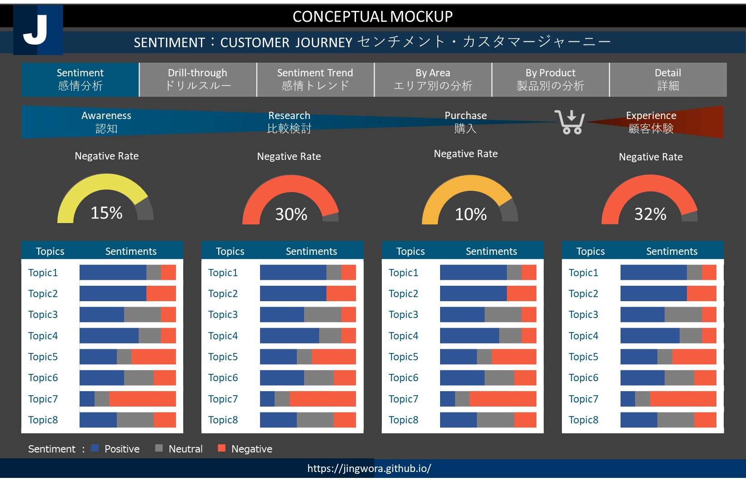
カスタマージャーニー全体の感情分析
各カスタマージャーニーのステージの顧客の感情を把握し、適切対応が可能
不満の原因を掘り下げて、より深く顧客満足度を高められる
ボトルネックを見つけて、顧客ロイヤルティの向上
お客様情報：日本の運輸企業（顧客サービス部）
Sentiment Analysis across customer journey
Understand the emotions of customers on each stage of each customer journey and respond appropriately
Dig deeper into the causes of dissatisfaction and increase customer satisfaction more deeply.
Identify bottlenecks and provide right solution to improve customer loyalty
Client: Transportation Company (Customer Service Department)
DATAFLOW ARCHETECTURE
CS phone
script
chatbot
email
Data Lake
Storage
Data
Factory
Azure Text
Analytics API
SQL
Server
Power BI
Raw
Data
(CSV)
Raw
Data
(CSV)
Raw
Data
(CSV)
Processed
Data
(CSV)
Sentiment
Database
Reports

Slide 39
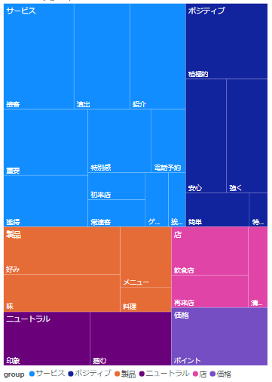
CONCEPTUAL MOCKUP
TEXT ANALYTICS ：SALES MEMO ANALYTICS 営業メモテキスト分析
Keywords Analysis キーワード分析 | Drill-through ドリルスルー | Sentiment 感情分析 | By Area エリア別の分析 | By Product 製品別の分析 | Detail 詳細
Sales Process
販売プロセス
Word Cloud
ワードクラウド
Manuscript
原稿
Prospect 3,000
特別感を演出するためには、時には意外性も重要です。好みに応じた一品をサービスしてみたり、試作品を試食してもらうのもいいでしょう。もちろんほかのゲストと差をつけるのは一概に良いとは言えません。ですので、日ごろの感謝の気持ちを伝える程度の、絶妙なさじ加減でサービスを加えるのが良いでしょう。
Qualified lead 1,500
Number by Topic（件数）
Topics | Number
サービス
店
価格
キャンペーン
製品
Success
600
Fail
900
After Sales 400
https://jingwora.github.io/

Slide 40
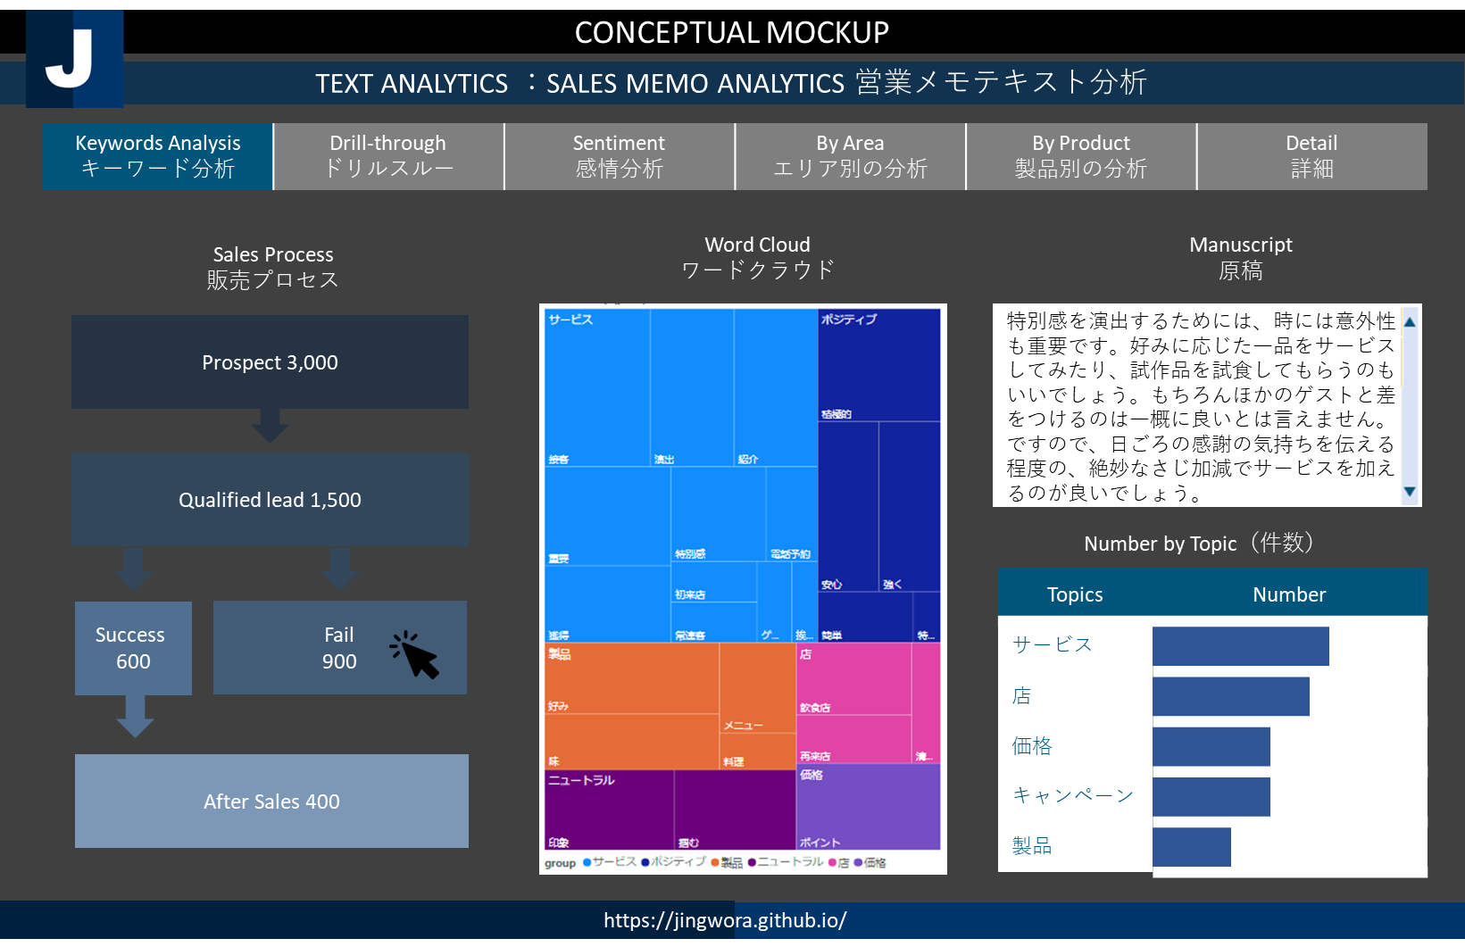




ソリューション：
営業支援のために、応対履歴のデータより、成約要因／解約要因を把握します。
優先リストと最適な戦略を作成してアウトバウンド業務を効率化
顧客のセグメントと組み合わせて成功パターンを分析します。
お客様情報：日本の車メーカー（営業部門）
Solutions:
Supporting sales team by understanding reason of success and fail sales approach.
Increase efficiency by identify priority list and suitable strategy.
Understand successful pattern for each customer segment.
Client: Leading Car Manufacturer (Sales Department)
ENVIRONMENT ARCHETECTURE
DEV
OPS
USER
Data Warehouse
Ingest
Power BI
SSMS
Blob
Storage
SSAS
SQL
Server
AI
Stop word
Replace word
Word category
Power BI
Desktop
Python
Local + Cloud
Cloud
Visualization

Slide 41
CONCEPTUAL MOCKUP
STUDENT PERFORMANCE ANALYSIS 成績評価分析
Performance Analysis 成績評価分析 | Comparison Report 比較レポート | Course Analysis 科目分析 | ML Clustering クラスター分析 | ML Forecast 予測分析 | ▶
Year 年度
2020 | ▼
KPI1
KPI2
KPI3
KPI4
Semester 学期
秋学期 | ▼
School Info 学校情報
Class Info 科目情報
Trends 傾向
Correlation 相関係数
Student Info 学生情報
2020 S1 | 2020 S2 | 2021 S1 | 2021 S2 | 2022 S1 | 2022 S2 | 2023 S1 | 2023 S2
F
a
c
t
o
r
1
Questionnaire 調査情報
Periods
● KPI
Factor2
● Group A ● Group B
https://jingwora.github.io/

Slide 42
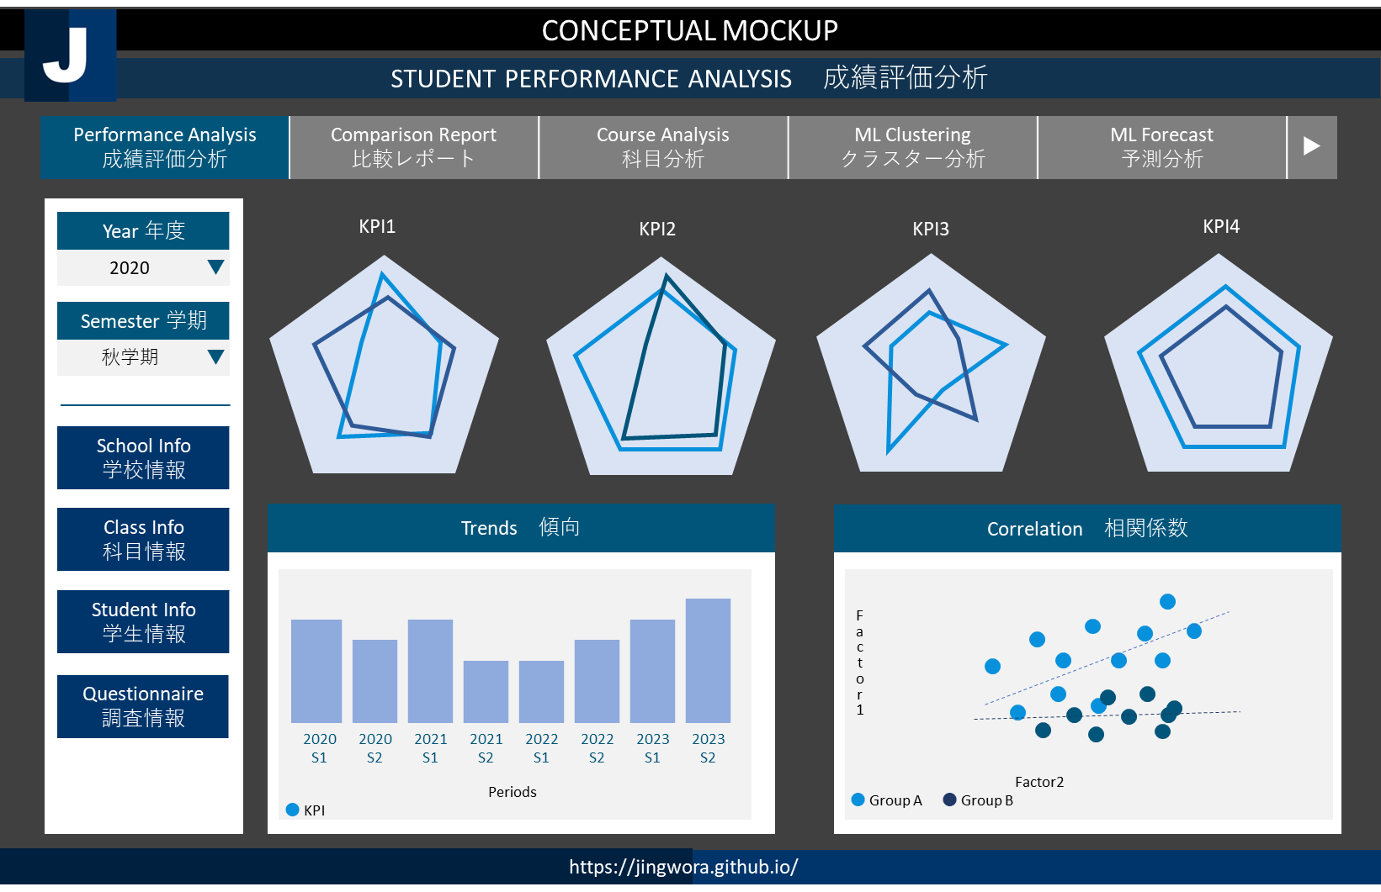



ソリューション：
・学生・教員評価のシステム化に基づいて 、PDCA改善のサイクルがスムーズに移行し、早める
・人人の学生の成績、個性、 特色に応じて指導・学習支援の最適化
・採用ニーズの変化に合わせてカリキュラムを提供する学習支援する
お客様情報：日本の一流大学
Solutions:
・Improve and speed up PDCA cycle by preparing faculty and student evaluation system.
・Understand student performance, characteristics and needs to provide best learning support.
・Provide most suitable curriculum that meets changing job market.
Client: Leading University in Japan
ENVIRONMENT ARCHETECTURE
DEV
OPS
USER
Ingest
AI
Data Lake
Storage
Synapse
Analytics
Azure
AutoML
Power BI
Git
Bronze | Silver | Gold
Power BI
Desktop
Local + Cloud
Cloud
Visualization

Slide 43
CONCEPTUAL MOCKUP
APP ANALYTICS REPORT アプリ分析レポート
App アプリ
EU | ▼
App Performance Analysis アプリパフォーマンス分析 | Funnel Analysis ファネル分析 | Channel Analysis チャンネル分析 | Monetize Analysis 収益化分析 | ▶
Country 国
Germany | ▼
Department
ALL | ▼
Product 製品
ALL | ▼
Period 期間
2020 | ▼
https://jingwora.github.io/

Slide 45
CONCEPTUAL MOCKUP
CUSTOMER RETENSION REPORT 新規顧客獲得・顧客維持レポート
Region 地域
EU | ▼
Customer Retention 顧客維持 | Churn Analysis チャーン分析 | Action Plan 行動計画 | Action Tracking
Country 国
Germany | ▼
Churn
解約
(Actual vs Plan)
CURREN TIMELINE
現在タイムライン
(Actual vs Plan)
CURREN TIMELINE
現在タイムライン
(Actual vs Plan)
Department
ALL | ▼
￥1K
￥ 2.5K
￥
Product 製品
ALL | ▼
Period 期間
2020 | ▼
https://jingwora.github.io/

Slide 46
CONCEPTUAL MOCKUP
CUSTOMER SERVICE ANALYSIS 顧客満足度分析
Customer Journey | NPS 顧客満足度
PROSPECT
PURCHASE
USE
AFTER USE
Call Center
Call Center
TV Ads
Service Center
Store
Website
APP
E-mail
Landing Page
APP
LINE
Call Center
Website
YouTube
APP
APP
Twitter
Chatbot
Facebook
https://jingwora.github.io/

Slide 47
Multi-dimension analysis
Alert
Regular Report
Transaction Analysis
Statistical Analysis
Dossier library (Microstrategy)

Slide 48



Slide 49













PYSPARK
SKLEARN

Slide 50









DATA PREPARATION
ARTIFICIAL
INTTELIGENCE
DATA CLEASING
WEB
SCRAPING
MACHINE
LAEARNING
MACHINE
LAEARNING
NEURAL
NETWORK
DEEP
LAEARNING

Slide 51

WWW

Slide 53



Slide 54




